Slide 1
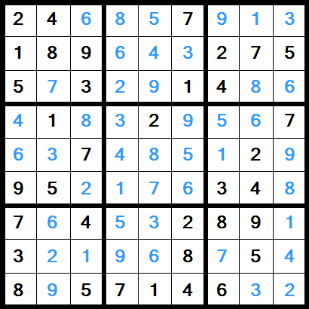
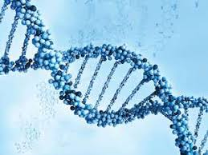
Solving Sudoku Using Genetic Algorithm
INFO 6205 Program Structure Algorithms

Slide 2
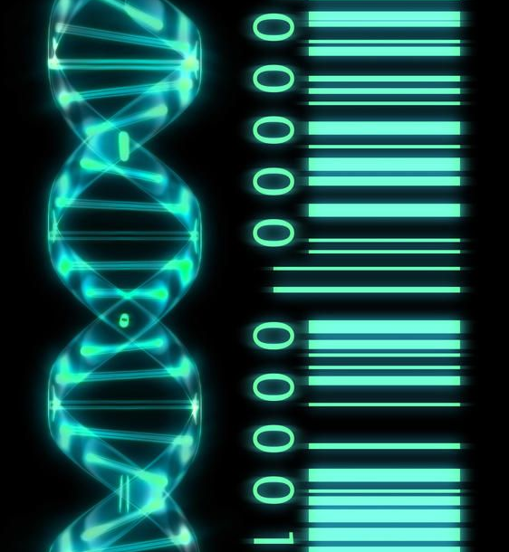
Introduction To Genetic Algorithm
Genetic Algorithm is used for solving optimization problems that are based on natural selection.
This process is derived from Biological Evolution.
GA is not a mathematical algorithm. The optima or the optimum solution is determined through evolution from generation to generation.
Through this process the fitter the chromosome is the better is the tendency to generate better solution of offspring.

Slide 3
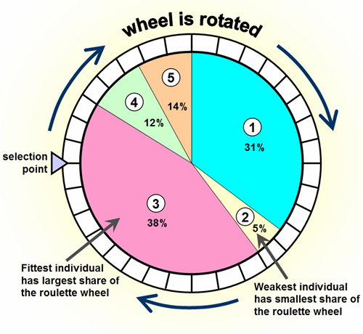
Selection Process used in solving Sudoku
The Selection used is : Roulette Wheel Selection.
A Random Checkpoint is generated and compared with the ratio of individual and population fitness.
On comparison if an individual is found to have greater fitness probability the same is selected and passed on as a fit chromosome.

Slide 4
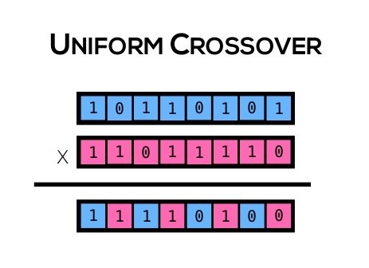
Crossover Process used for Solving Sudoku
The phenotypes of a generation are formed by, performing Uniform Crossover on the genotypes.
These Genotypes are the fit individuals selected from the previous generation.
The resulting phenotypes after the crossover forms the new child generation.

Slide 5
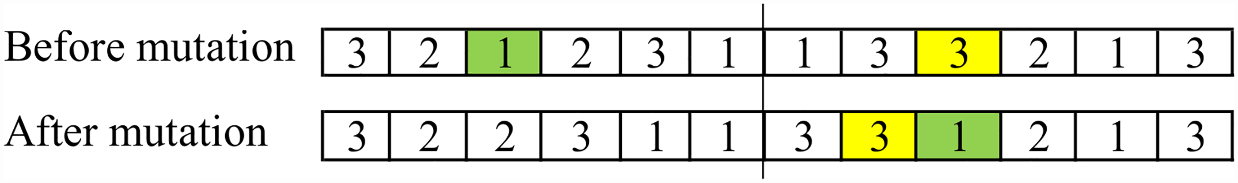
Mutation Process used for Solving Sudoku
The phenotypes of a generation are formed by, performing Uniform Crossover on the genotypes.
These Genotypes are the fit individuals selected from the previous generation.
The resulting phenotypes after the crossover forms the new child generation.

Slide 6
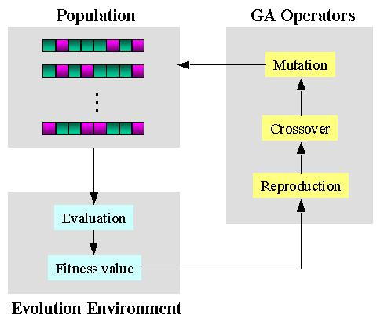
Fitness Function
The Genetic Algorithm uses a fitness function as a discriminator between the solution quality which is represented by the chromosomes.
The Fitness Function used in programming is (216- GridConflicts)/216.

Slide 7
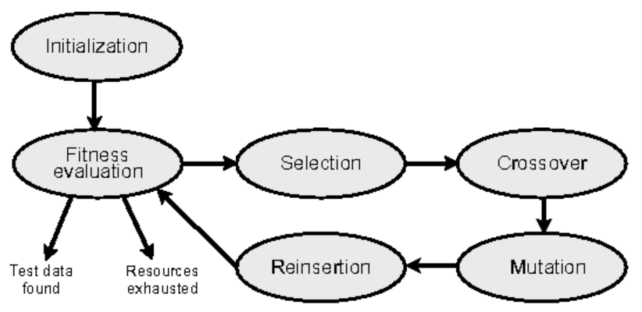
Reinsertion Criteria in Sudoku Solver
After every 20 generations if the conflicts do not generate better solutions, the problem is reinserted i.e the initial grid is re inserted as a problem to the program

